Slide 1
Mathematical Expectation

Slide 2
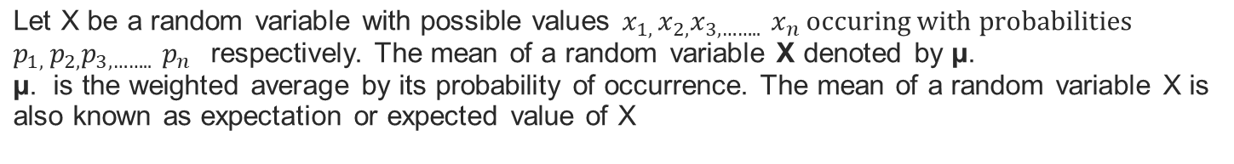
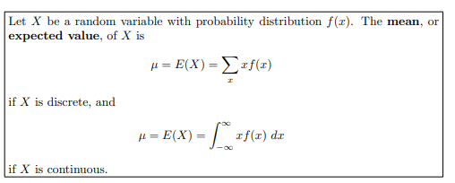
Mean of Random Variables

Slide 3
Probability Distributions for Discrete Random Variables
The probability distribution of a discrete random variable is a graph, table or formula that specifies the probability associated with each possible outcome the random variable can assume.
  p(x) ≥ 0 for all values of x
  Σp(x) = 1

Slide 4
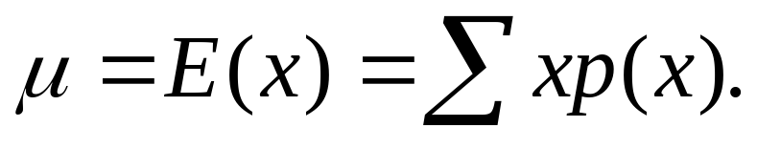
Expected Values of Discrete Random Variables
The mean, or expected value, of a discrete random variable is
  Mean: E(X) = μ

Slide 5
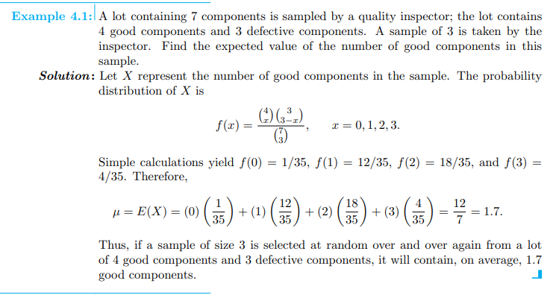
Example: Discrete Random Variables

Slide 6
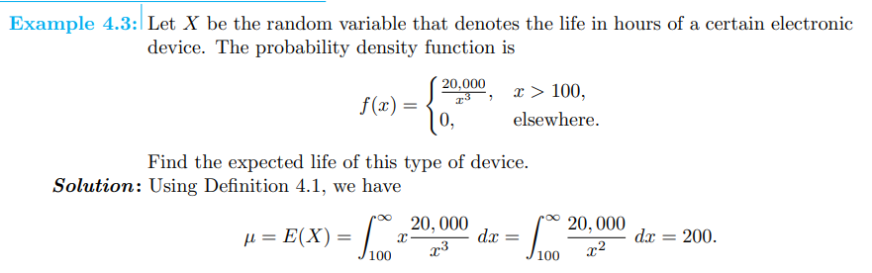
Example: Continuous Random Variables

Slide 7
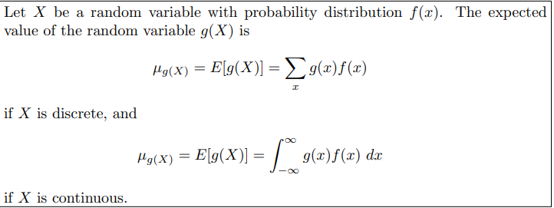
Mean of Random Variables

Slide 8
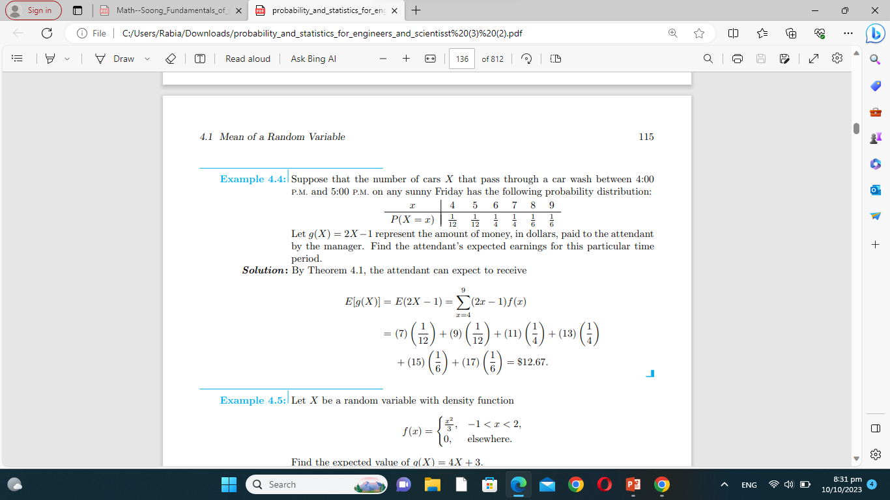
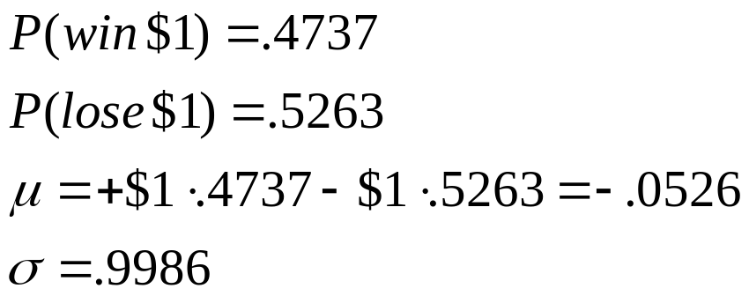
Example: Discrete Random Variables
In a roulette wheel in a U.S. casino, a $1 bet on “even” wins $1 if the ball falls on an even number (same for “odd,” or “red,” or “black”).
The odds of winning this bet are 47.37%
On average, bettors lose about a nickel for each dollar they put down on a bet like this.
(These are the best bets for patrons.)
McClave, Statistics, 11th ed. Chapter 4: Discrete Random Variables

Slide 9
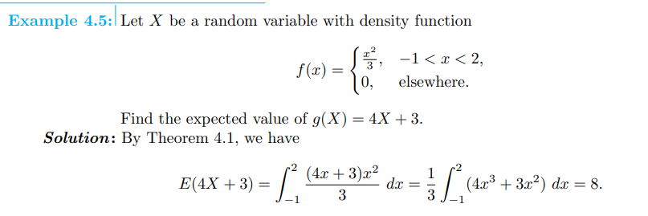
Example: Continuous Random Variables

Slide 10
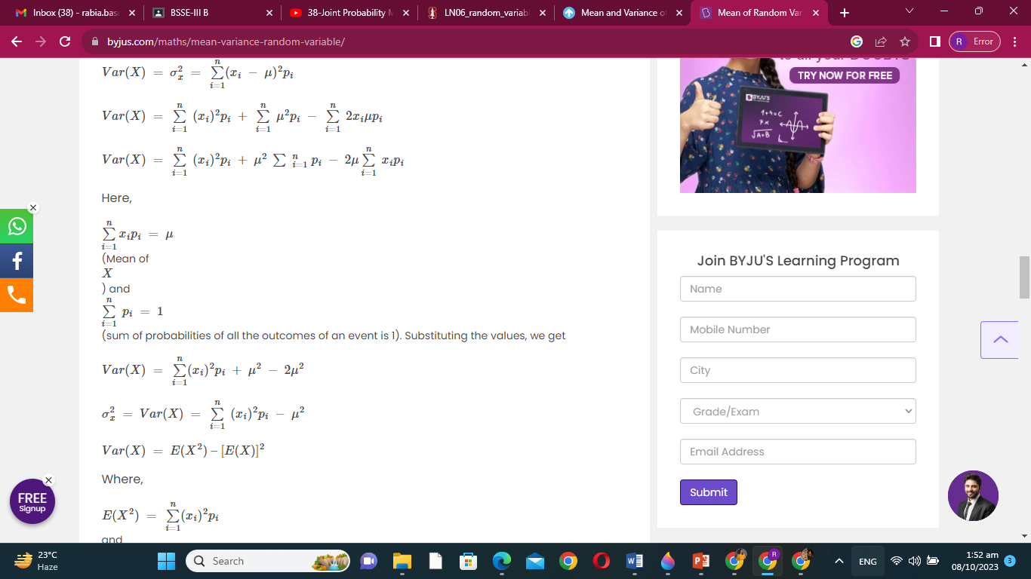
Variance of Random Variables

Slide 11
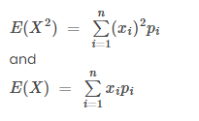
Variance of Random Variables

Slide 12
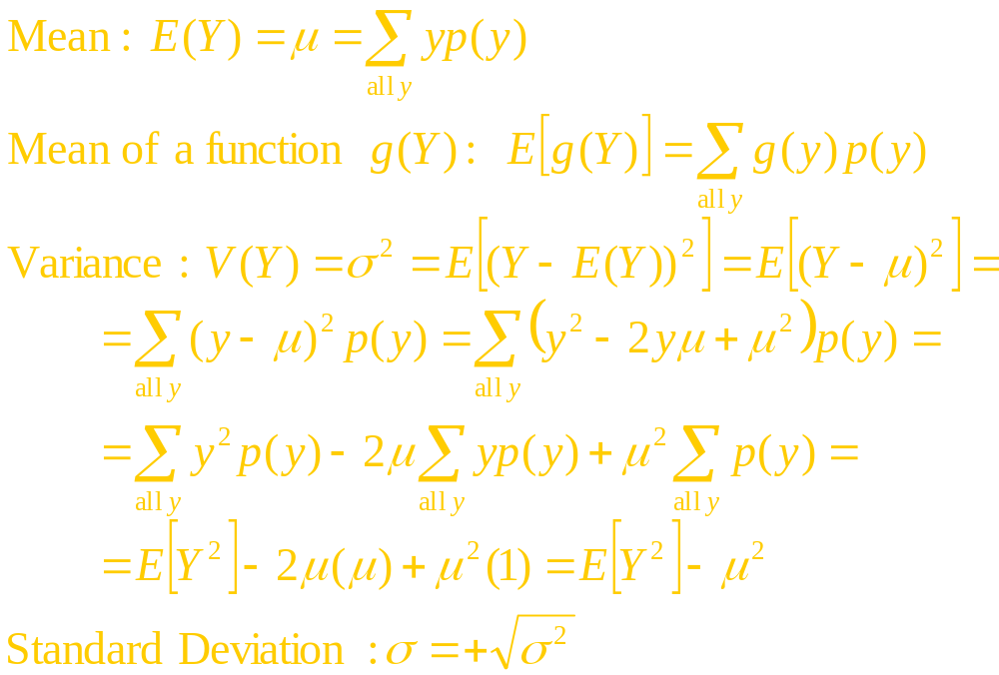
Variance of Random Variables

Slide 13
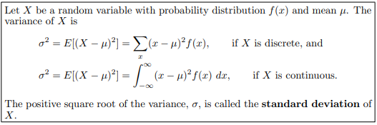
Variance of Random Variables

Slide 14
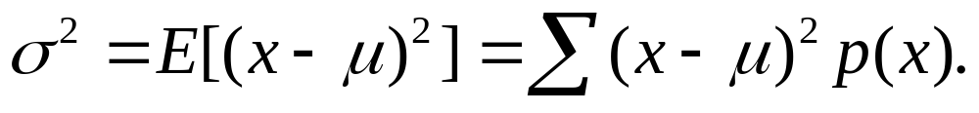
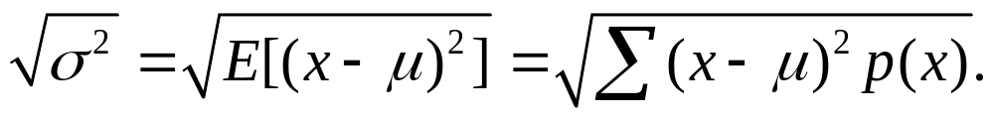
Variance of Discrete Random Variables
The variance of a discrete random variable x is
The standard deviation of a discrete random variable x is

Slide 15
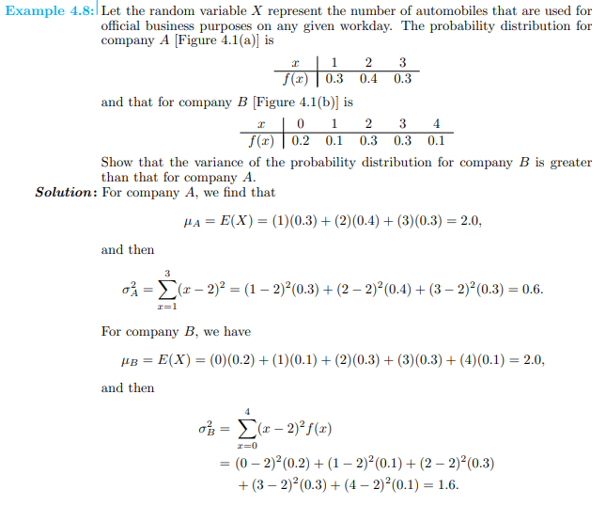
Example: Discrete Random Variables

Slide 16

Variance of Discrete Random Variables

Slide 17
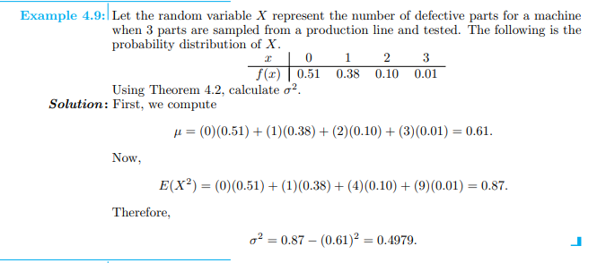
Example: Discrete Random Variables

Slide 18
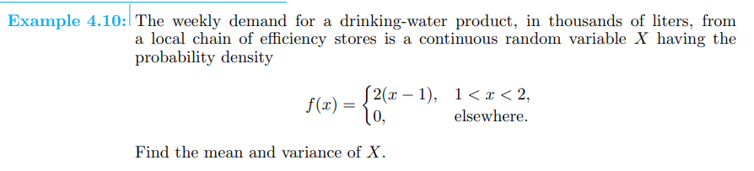
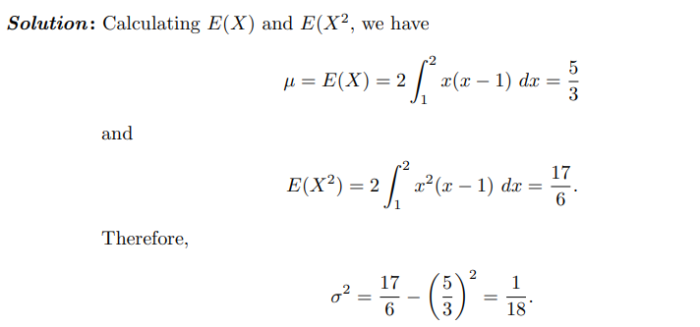
Example: Continuous Random Variables

Slide 19
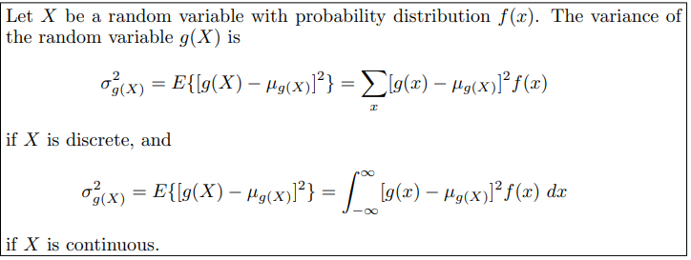
Variance of Discrete Random Variables

Slide 20
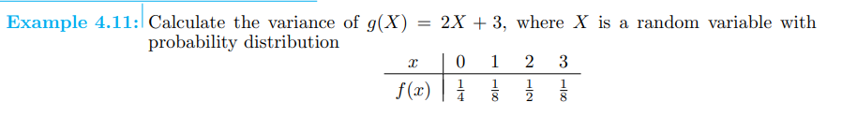
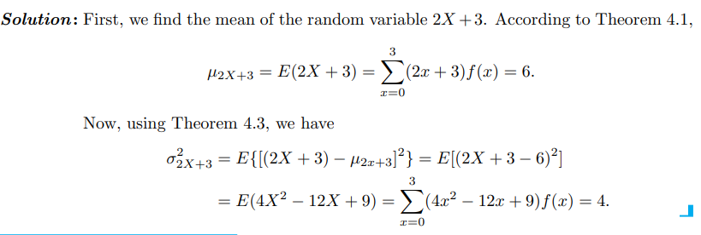
Example: Discrete Random Variables

Slide 21
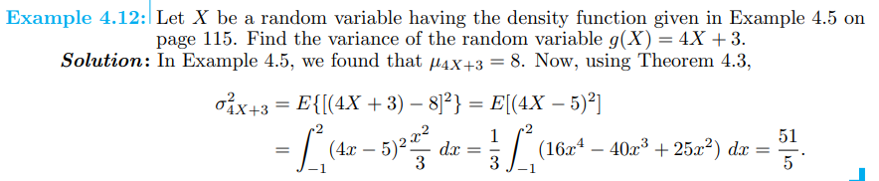
Example: Continuous Random Variables

Slide 22
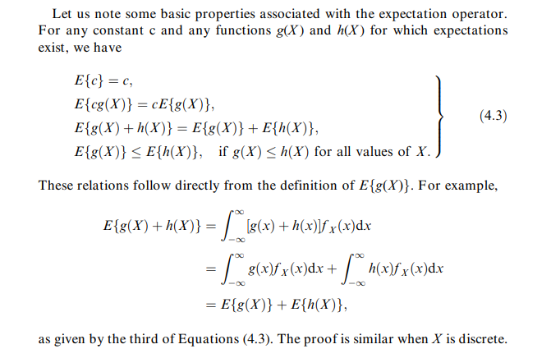
Properties of Expected value of X

